Slide 1
What is prototyping?

Slide 2

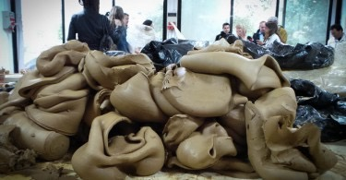
POTTERY CLASS

Slide 3

What prototyping ISN’T
Sketches
Wireframes
Mockups

Slide 4

Well what IS prototyping?
Design
Learn
Build
Test

Slide 5
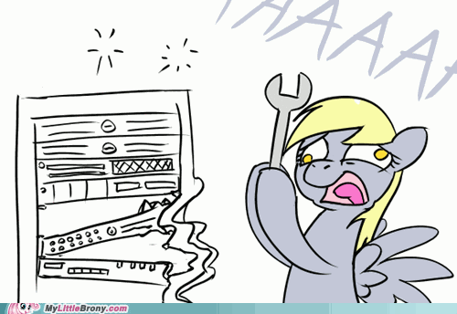

Prototyping tools
Paper
Native app
HTML

Slide 6
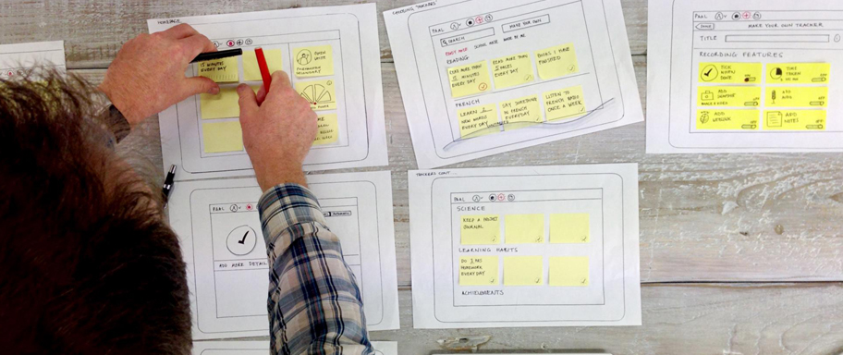
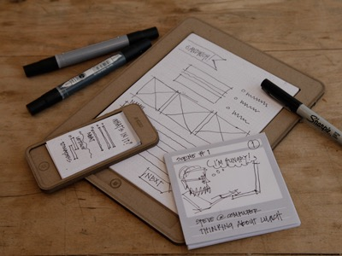
Paper
Pros
Quick & easy to make
Users don’t get bogged down with visual design
Cons
Can’t use remotely
One user at a time
Flows, but not animations

Slide 7
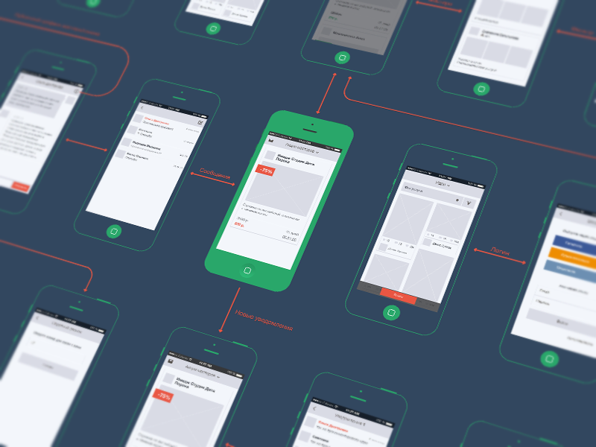
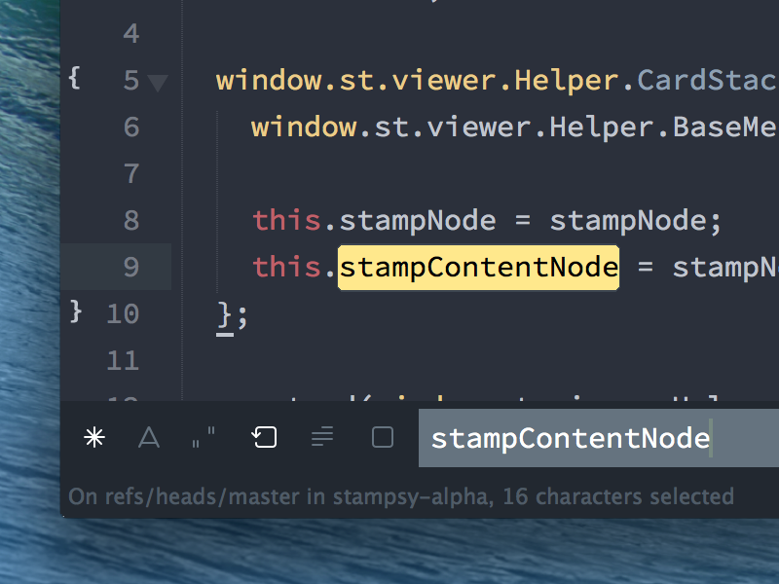
Native app
Pros
Real feeling
Testable interactions
Easy to distribute
Cons
Hard to make
Changes can take a while

Slide 8
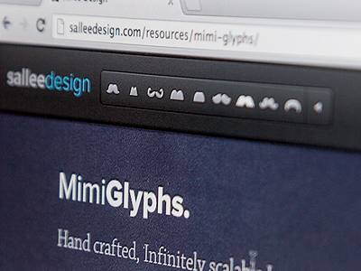
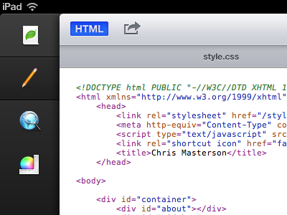
HTML
Pros
Quick to build
Test interaction
Tell a story
Cons
Users will critique designs

Slide 9
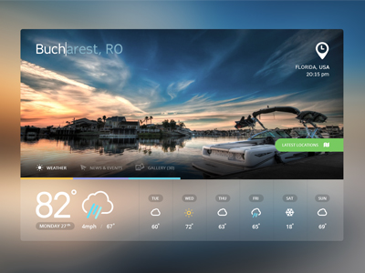
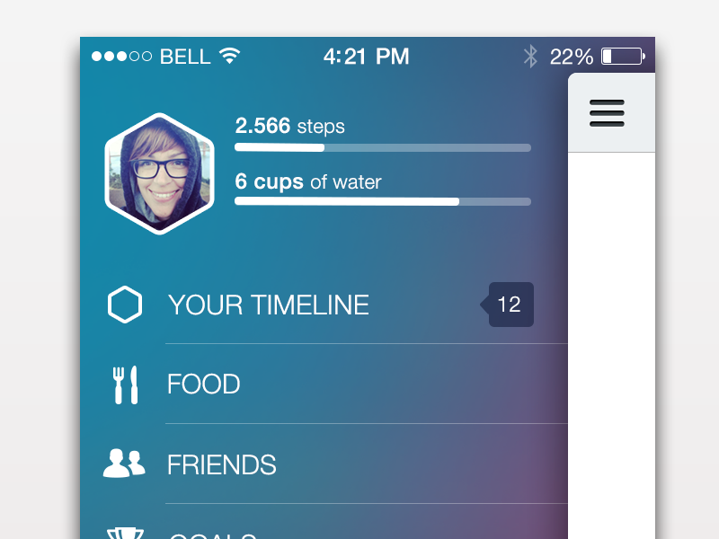
Things to focus on
Tell a story
Back-end functionality can be faked
Functioning weather vs icons
Stay focused on a goal
Is what your trying to tell the user getting across?

Slide 10

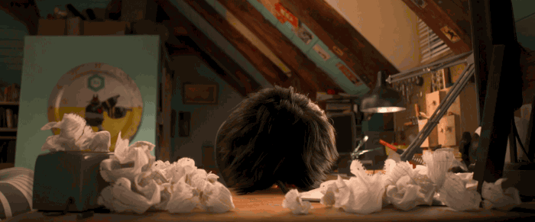
Things to avoid
Getting caught up in content details
Dummy content is okay!
Trying to be perfect
Its okay to have mistakes!
Be ready to talk around any problems that may arise!

Slide 11
Move Fast
&
Break Things

